Slide 1
Banking Risk & Credit Portfolio Intelligence Platform
Aurora National Bank
Name Ps No.
Abdur Raziq Fareed R 10842741
Mamatha HA 10842673
Divyalakshmi M 10842651
Naveena G 10842645
Parth Dange 10842621
Pranjal Sharma 10842663
Trained by: Babjee Reddy
Mentored by: Vijayendra Suryawanshi
PRESENTATION BY: GROUP 1

Slide 2
Index
Project Overview
Architecture
Data Overview
Methodology
Monitoring
Visualization
Project Timeline

Slide 3

Problem Statement
Managing credit risk and loan portfolio analytics for Aurora National Bank is challenged by fragmented and dispersed data sources, manual ETL tasks, and lack of timely insights. Sensitive financial data needs advanced masking, and stakeholders require accessible, interactive dashboards while ensuring scalability for growing data volumes.
Key Issues
Lack of Insights: The absence of real-time analytics makes it difficult for making decisions​.
Manual Processes: ETL flows and data aggregation tasks are slow.
Data Security: Personally identifiable and financial information lacks control over data.
User Accessibility: Lack intuitive dashboards & BI capabilities for exploring portfolio data​.
Scalability Issues: No automated or scalable data pipelines to handle growing transaction volumes.
Data Complexity: Loan and customer data is scattered across different platforms.

Slide 4
Project Objectives
Centralize diverse banking data into a robust cloud warehouse.
Automate ETL pipelines for real-time, reliable data integration.
Develop credit risk scoring and segmentation.
Deliver dynamic Tableau dashboards for stakeholder insights.
Enhance data security and compliance with masking and audit controls.
Build scalable, future-ready analytics architecture.

Slide 5
Business Intelligence Solutions
Centralized data warehouse enables unified loan and customer analytics.
Automated pipelines deliver clean, timely data for risk assessment.
Advanced dashboards visualize portfolio metrics, trends, and credit scores.
Self-service analytics empower users to explore risk, tenure, and product performance.
Actionable insights support faster, data-driven decisions.

Slide 6
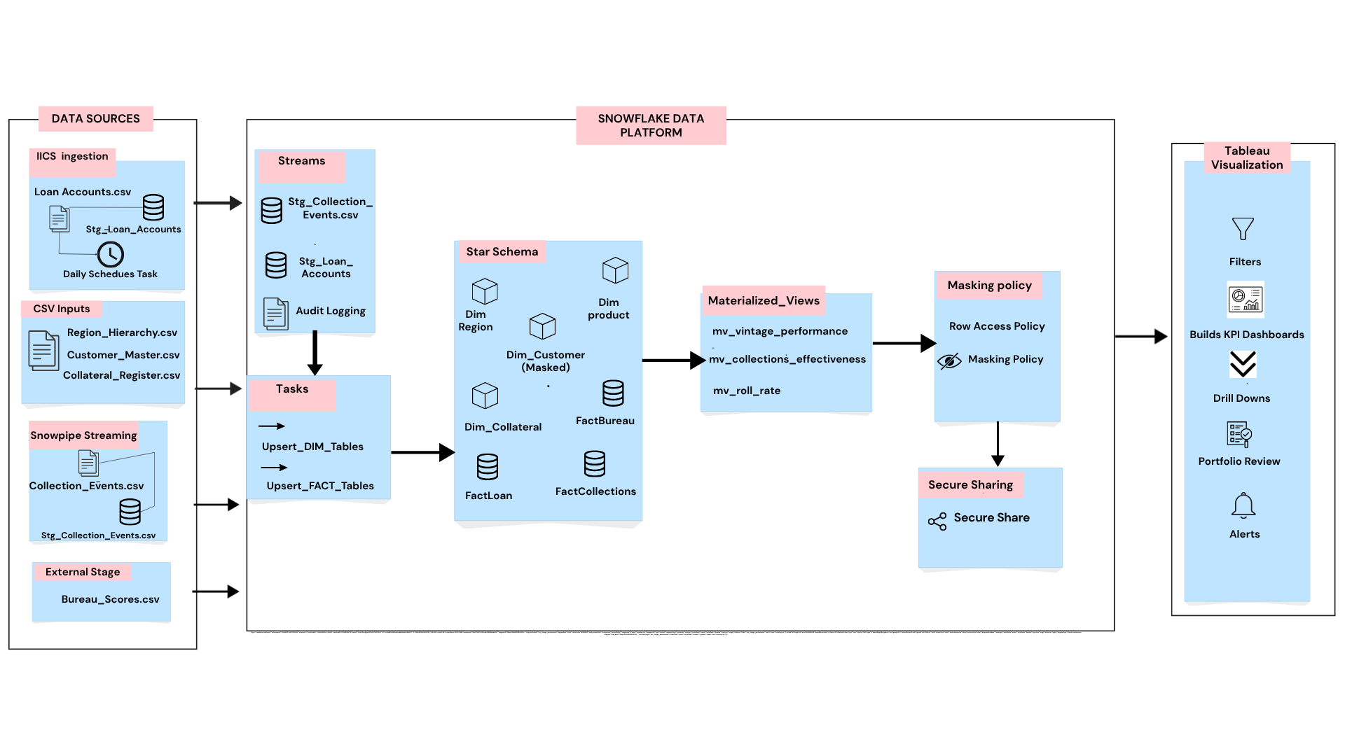
Architectural Workflow

Slide 7
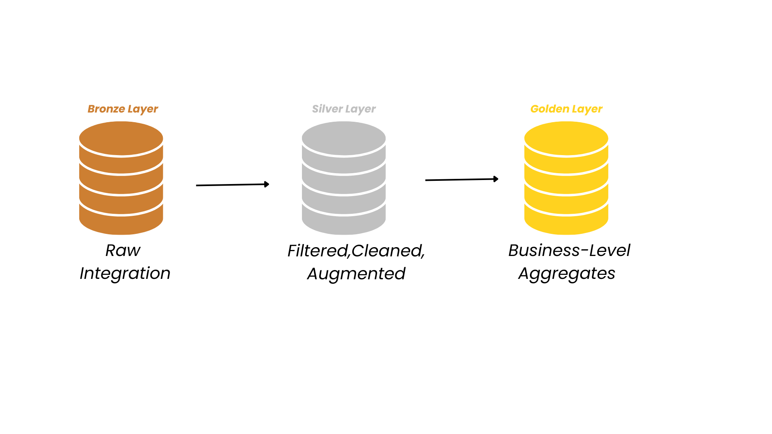
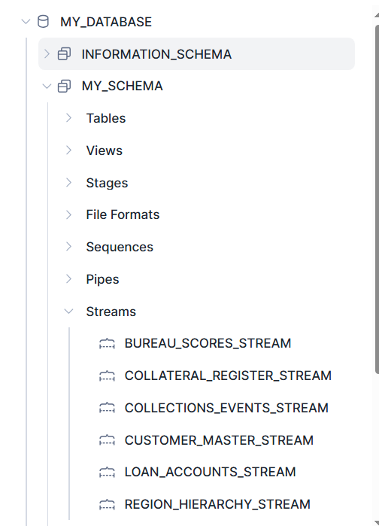
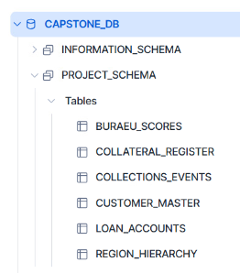
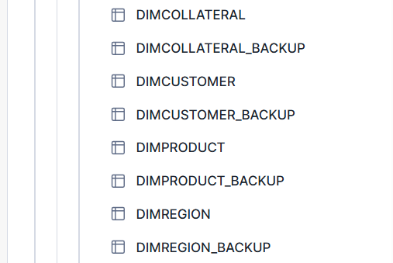
Layered Architecture

Slide 8
Data Overview
Data Volume
Database includes large volume of loan banking data, covering several banking products and segments.​
Portfolio Insights
Provides origination amounts, interest rates (APR), risk ratings, tenure months, and detailed product-level attributes for rich credit analytics.
Customer Coverage
Customers from diverse regions, including detailed demographics and complete loan repayment histories.
Product Coverage
Tracks the full loan lifecycle for all core banking offerings, allowing tenure estimation and risk segmentation for product-level analysis.

Slide 9
Data Sources:
customer_master:
Stores details of bank customers including demographics and contact
loan_account:
Captures all loan account data for each customer
collater_register:
Registers collateral assets linked to loan accounts
region_heriracy:
Maintains geographic region hierarchy for branch/customer mapping
beaure_scores:
Contains third-party credit (bureau) scores for customer risk
Collection _events :
events related to the collection and recovery process for overdue or at-risk loans.

Slide 10
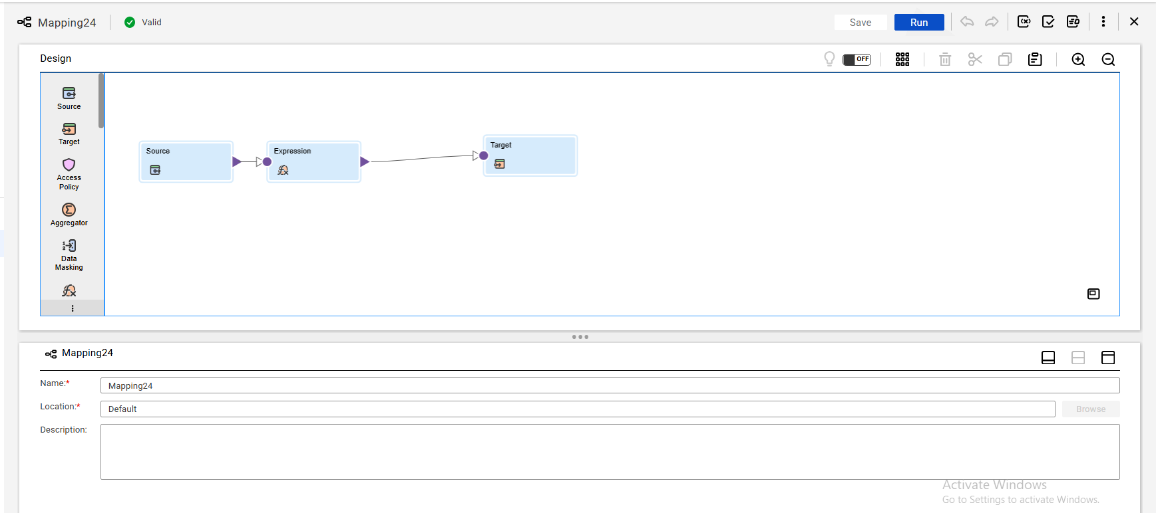
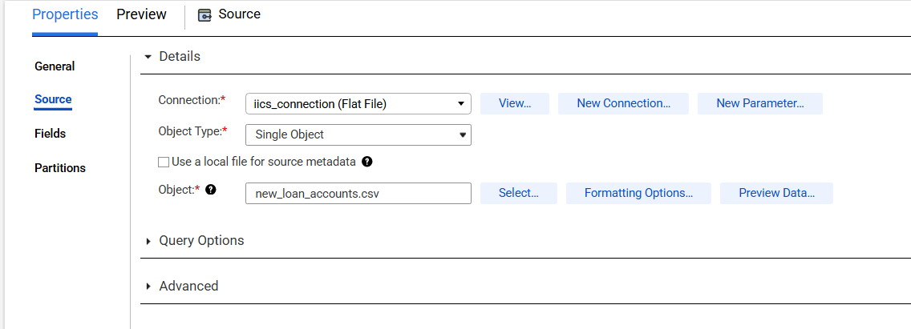
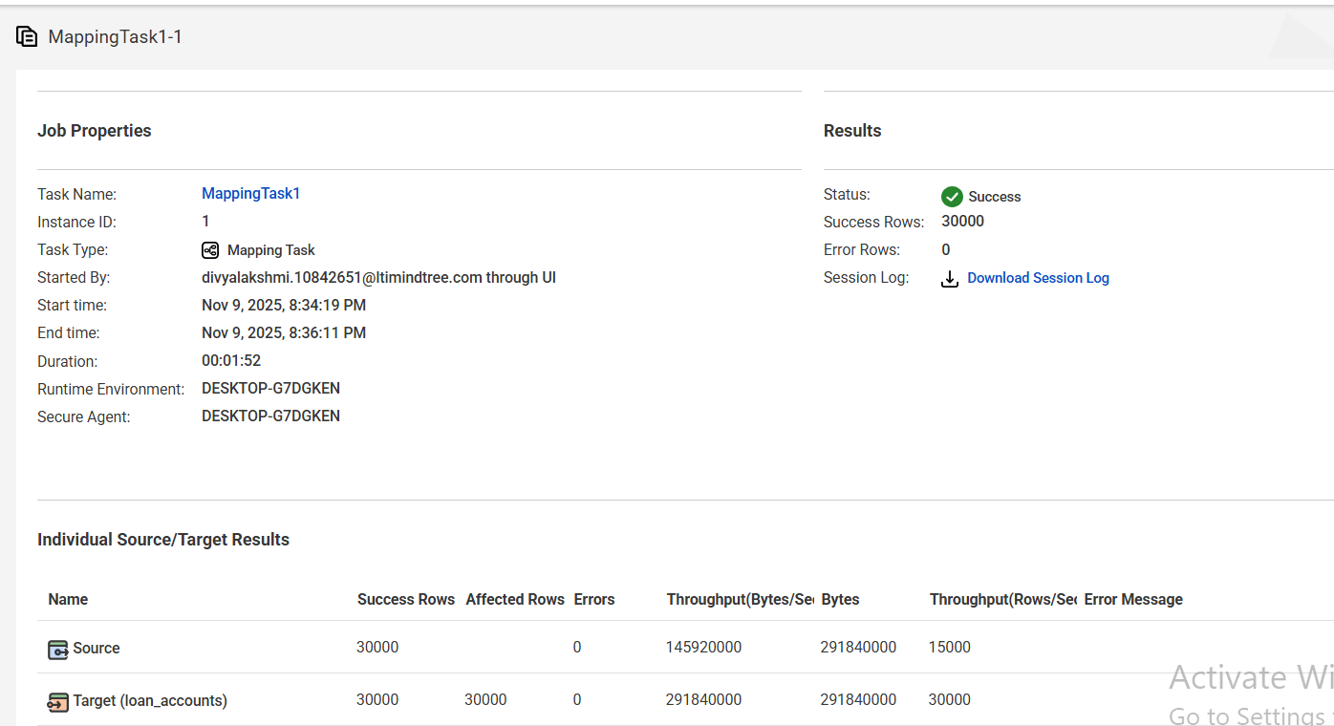
IICS Mapping
Source Extraction: Data is extracted from the Loan_Accounts core banking system in CSV format.
Target Loading: Transformed data is loaded into the stg_loan_accounts table in Snowflake for further downstream processing.
Automation: The entire data flow from source to target is orchestrated and monitored using an IICS Mapping.
Scheduling: A daily taskflow is configured in IICS to ensure automatic data refresh and synchronization between source and Snowflake.

Slide 11
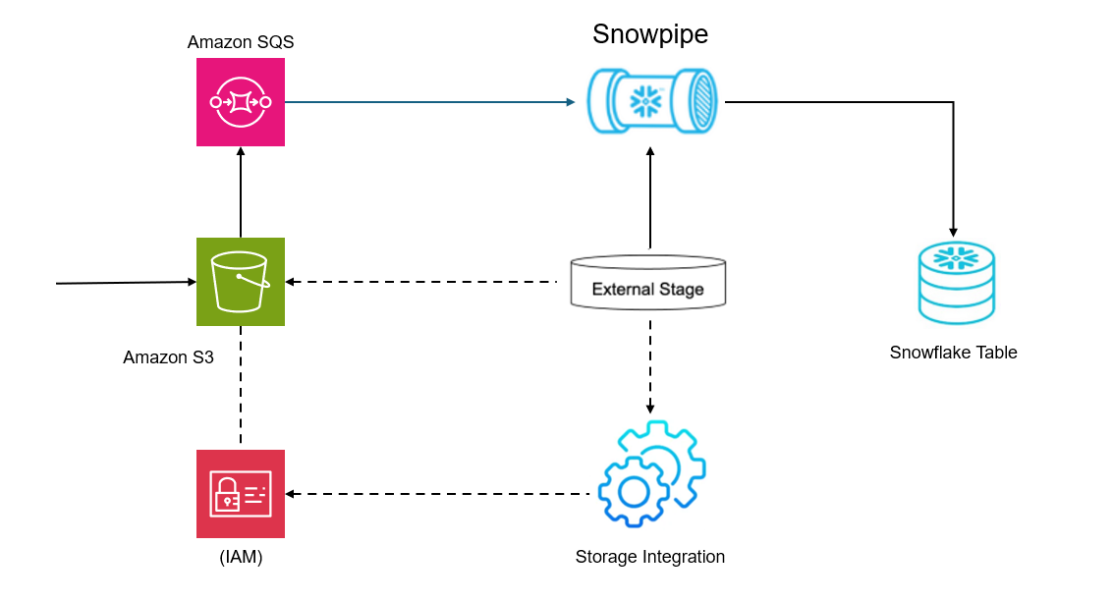
Automated Data Ingestion with Snowpipe
Step 1
Configure Cloud Storage
Step 2
Create Storage Integration in Snowflake
Step 3
Define External Stage
Step 4
Create Snowpipe
Step 5
Automate Data Loading
Step 6
Monitor and Validate

Slide 12
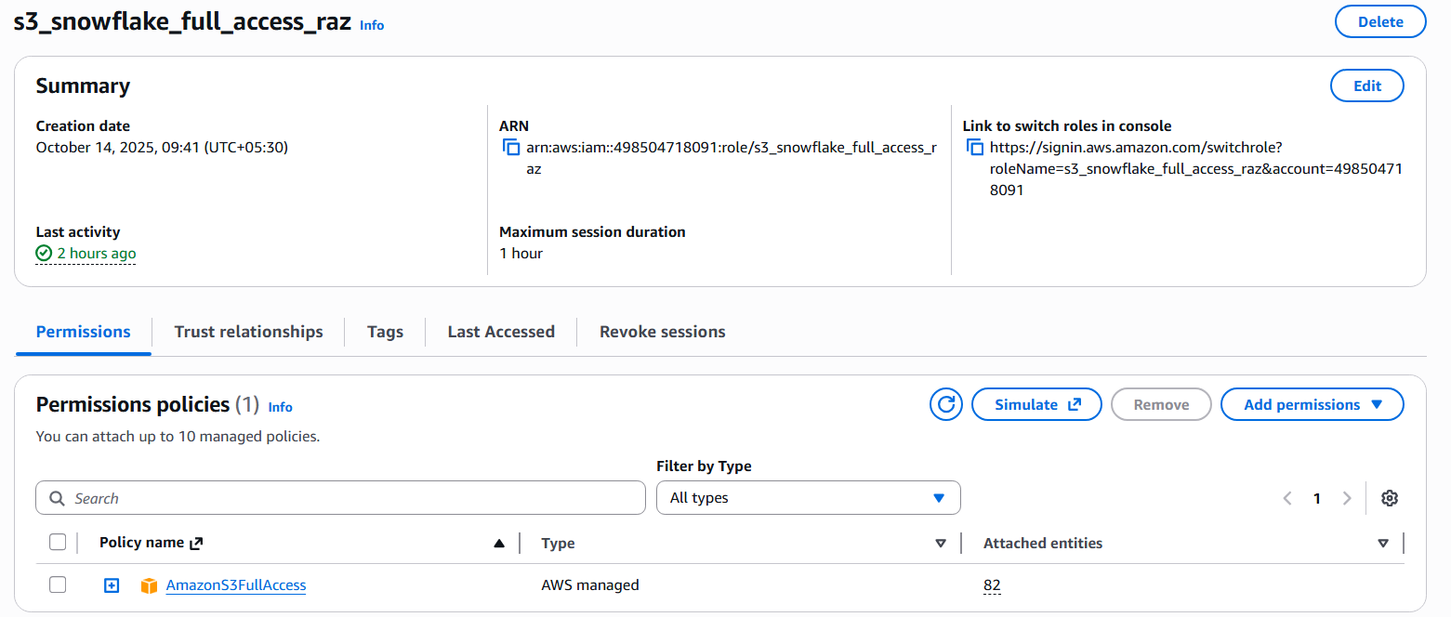
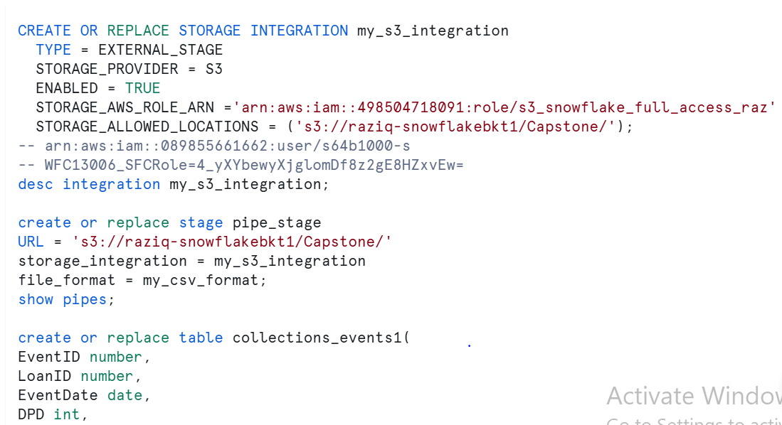
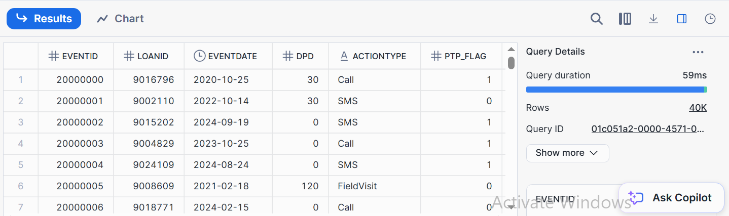
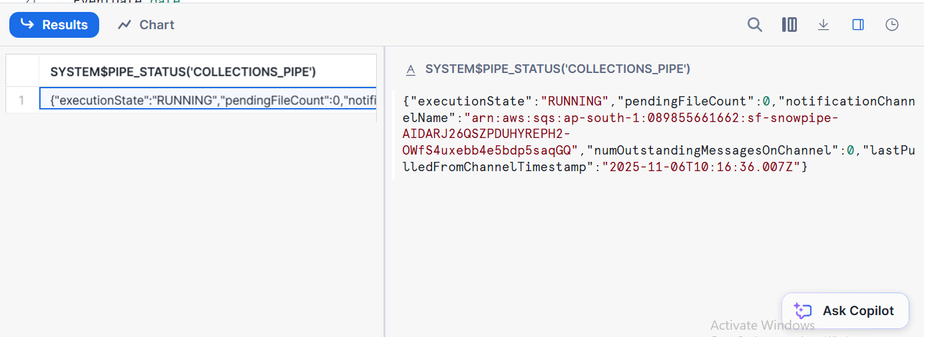
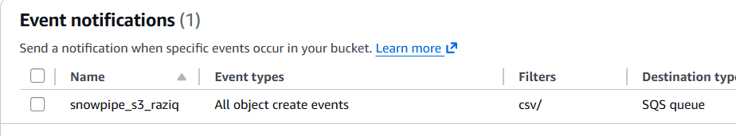
Snowpipe execution
Configure Cloud Storage
Create Storage Integration and External Stage in Snowflake
Monitor and Validate
Snow pipe running status
Notification channel

Slide 13
Data Preprocessing Steps
Data Format Standardization
Corrected all date fields to a unified format to prevent parsing errors and ensure chronological consistency.
Row Quality Filtering
Identified and dropped 98 rows where the loan closing date was earlier than the opening date, removing invalid records from analysis.
Imputation of Missing Values
For records where loan tenure (months) was zero (an impossible scenario), imputed values using the mean tenure of other loans for each respective product category to maintain data reliability.
Integrity and Consistency Checks
Ensured all key columns (loan_id, customer_id, product_id) were valid and present for each record, supporting clean joins and accurate analytics.

Slide 14
Dimension and Fact Tables
Dimension tables
Fact tables
Table Name | Description
dim_customer | Customer master info—name, demographic, segment
dim_product | Loan product details—type, terms, APR, risk band
dim_region | Branch or geographic hierarchy for each customer
dim_collateral | Collateral asset details used to secure each loan
Table Name | Description
fact_loan_account | Loan balances, draws, repayments, status change
fact_collection_event | Collection actions—PTPs, outcomes, dates, agents
fact_bureau_score | Credit bureau score snapshots for each customer/loan

Slide 15
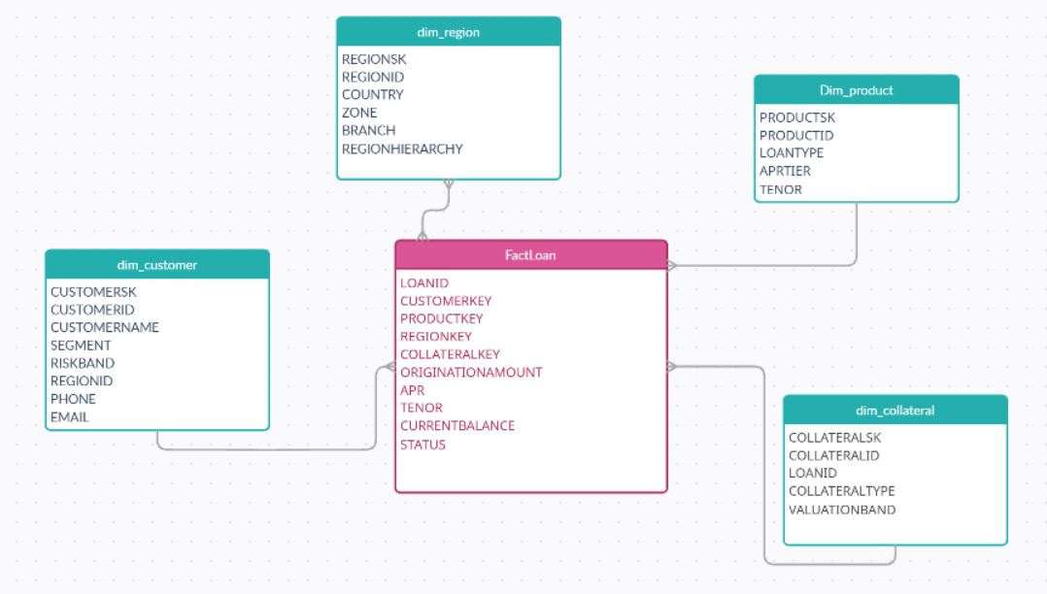
Star schema
A star schema is a data warehouse design that places a central fact table at the center, surrounded by dimension tables. The fact table captures quantitative business events (such as transactions or balances), and each dimension table provides descriptive attributes (like product, customer, region, or time).

Slide 16
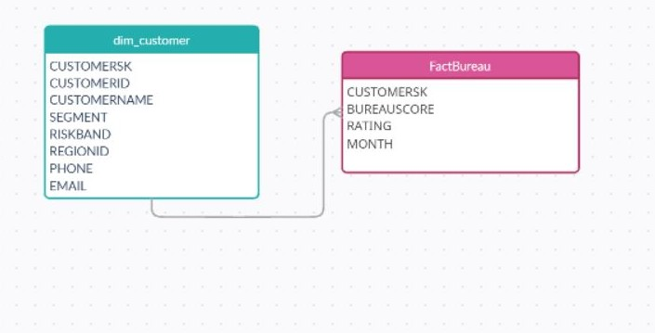
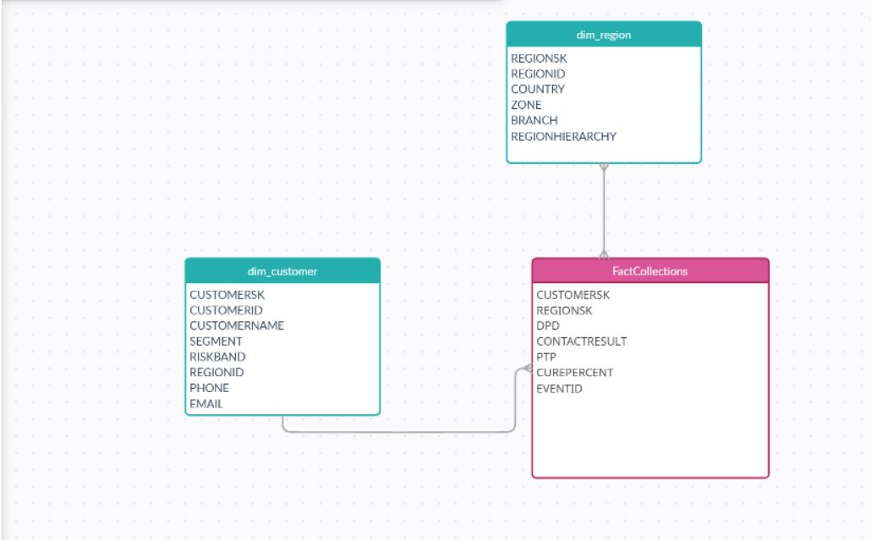
FactBureau & FactCollections

Slide 17
Streams
What Are Streams?
Streams in Snowflake track changes (INSERT, UPDATE, DELETE) to tables, capturing incremetal data modifications as they happen.
How the Streams used?
Streams enables automated audits and change capture for ELT and processing tasks.
Why Streams?
automate workflows by detecting new or updated records.
smooth data integration, CDC (Change Data Capture).
real-time updates to reporting layers.

Slide 18
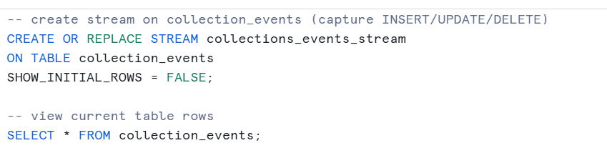
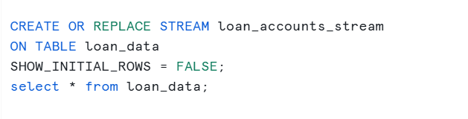
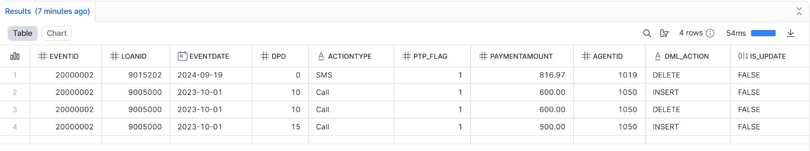
Stream creation on the tables
Output of streams capturing DML_actions and IS_UPDATE values

Slide 19
Tasks
Task Scheduling Logic
Tasks were scheduled to run automatically when new changes were detected in the streams—ensuring that only new or changed records are processed.
Chained Tasks Design
Tasks for dimension tables run first to ensure reference data (customer, product, region, etc.) is always up-to-date.
Fact table tasks are then triggered to load transactional and event data, maintaining referential integrity and complete analytics coverage.
Why This Approach?
Ensures accurate and fresh data for analytics, with fast, automated updates.
Minimizes resource usage by only processing changed data.
Supports real-time, robust credit risk and portfolio monitoring for your banking platform.
Streams
Base Table changes
Chained Tasks
Dimension table
Upsert into the dimension tables
Fact tables
Upsert into the Fact Tables
Task scheduling for the schema

Slide 20
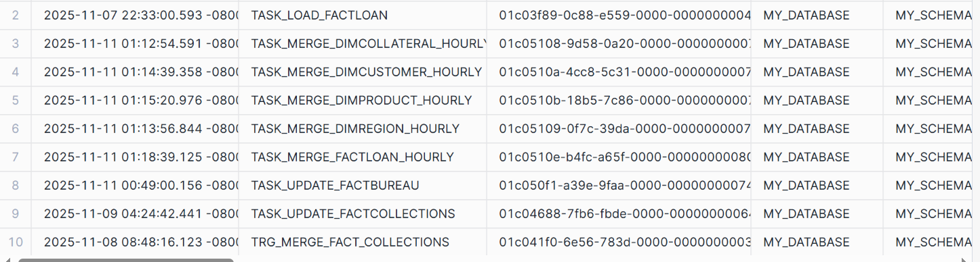
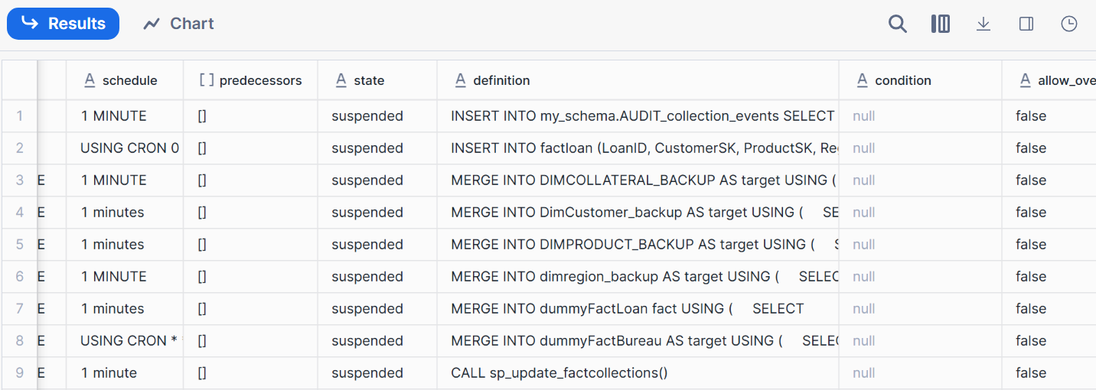
Tasks Execution
Tasks creation for the fact and dimension table
Tasks chain scheduling to avoid the inconsistency

Slide 21
Materialized views
Each view stores precomputed, resource-intensive aggregations—making dashboard queries ultra-fast and always up-to-date.
Reduces compute cost and query time compared to running raw tables for analytics.
mv_vintage_performance:
Aggregates loss ratio by origination month across loan portfolios.
mv_roll_rate:
Tracks transitions between delinquency buckets i.e.
mv_collections_effectiveness:
Summarizes Promise-To-Pay (PTP) kept percentage and cure rates for each loan_id.

Slide 22
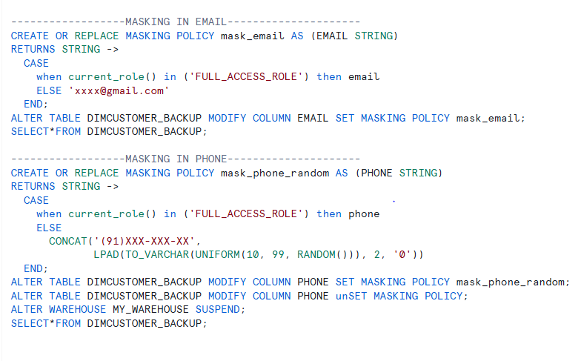
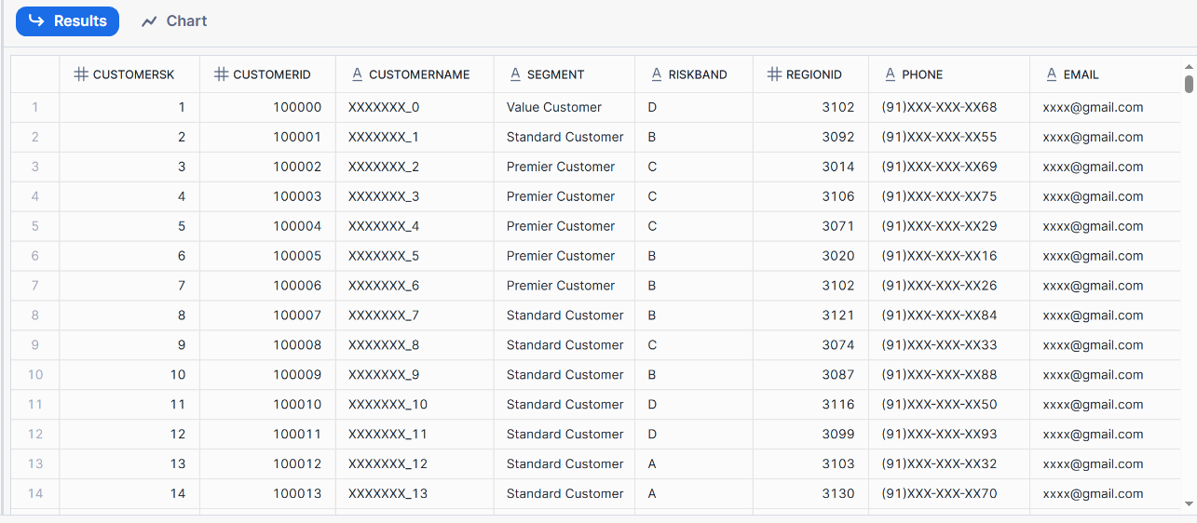
Data Masking
Applied in DimCustomer table:
Customer name
email
phone
These policies restrict visibility of personal information, showing masked values for users without Full Access roles.

Slide 23
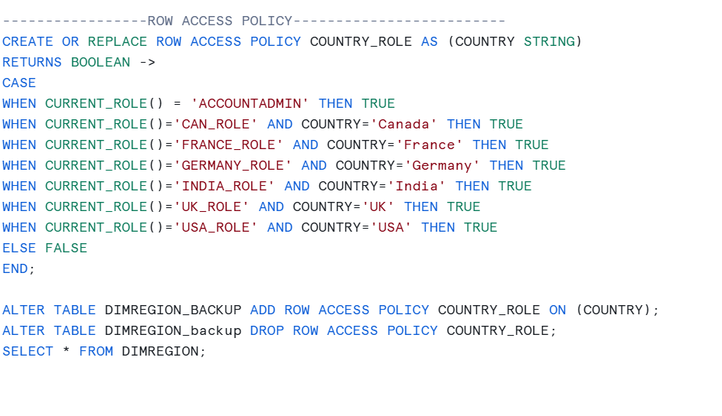
Row Access Policies were implemented to restrict portfolio access by country.
Only authorized roles can query data for their assigned countries, maintaining strict data segmentation and security.
Row Access Policy
Why These Features?
Protects customer privacy and sensitive info in compliance with regulations.
Enables controlled, role-based data access across business units.
Secures analytics platform for multi-region, multi-user banking environments.

Slide 24
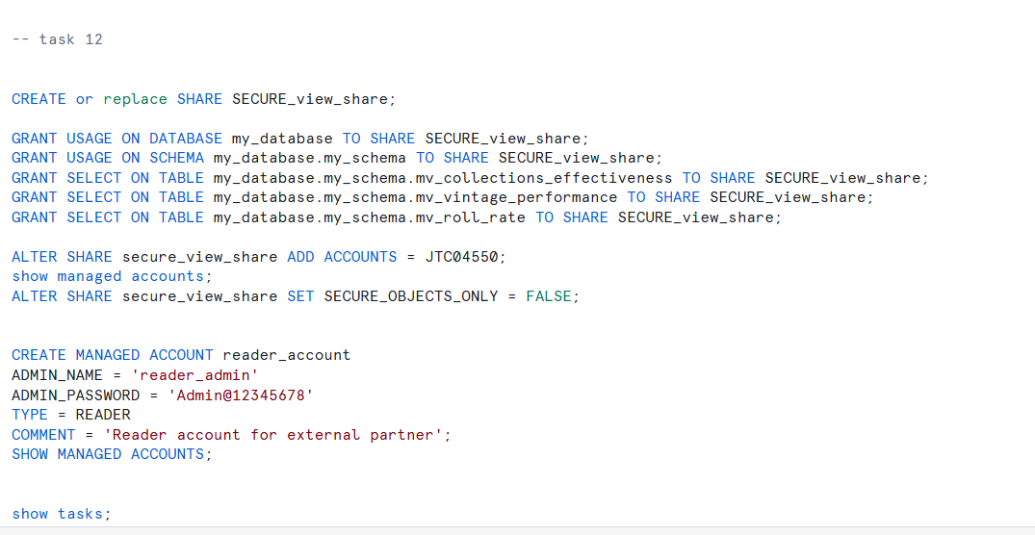
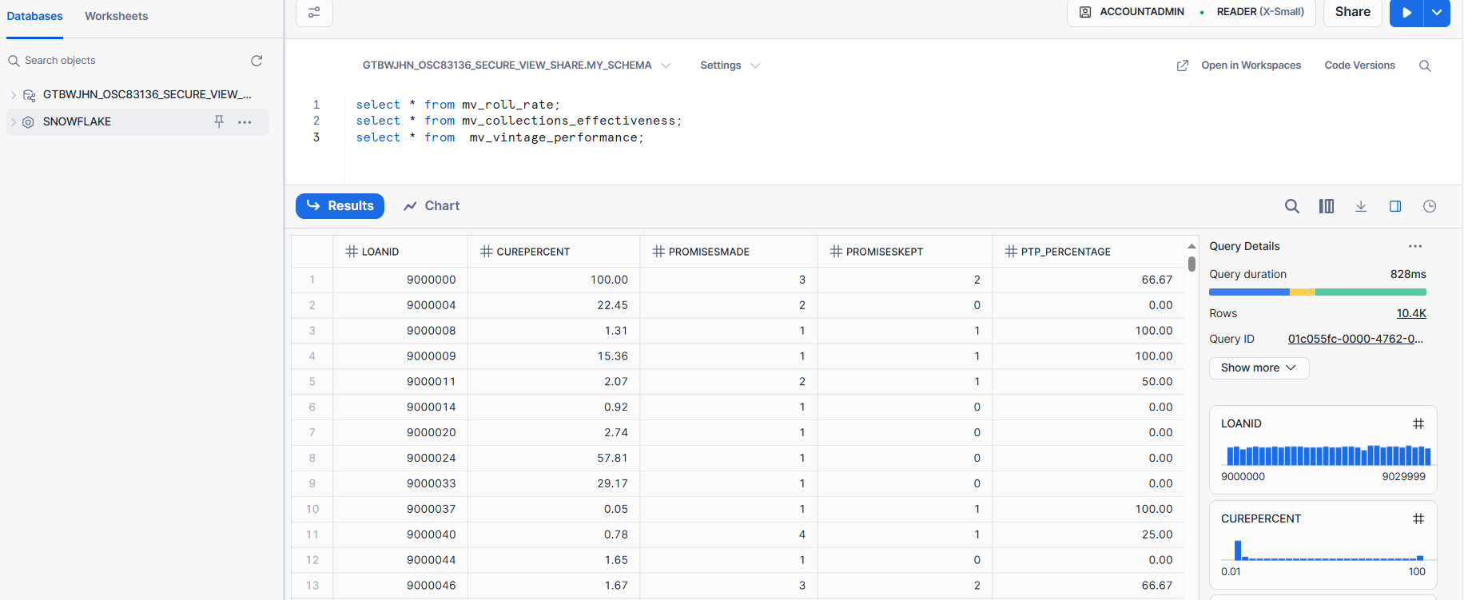
Data sharing
Established a secure data share to expose selected, approved data for controlled external access.
Shared views:
mv_vintage_performance
mv_collections_effectiveness
Reader Account Accessibility:
Tested and validated that external reader accounts can access only the designated materialized views included in the secure share.
Documenting Sharing Process:
The step-by-step sharing process was documented, including granting privileges, verifying access, and maintaining an audit trail for all share interactions.
Benefits:
Facilitates collaborative analytics between teams and business units without full data replication..

Slide 25
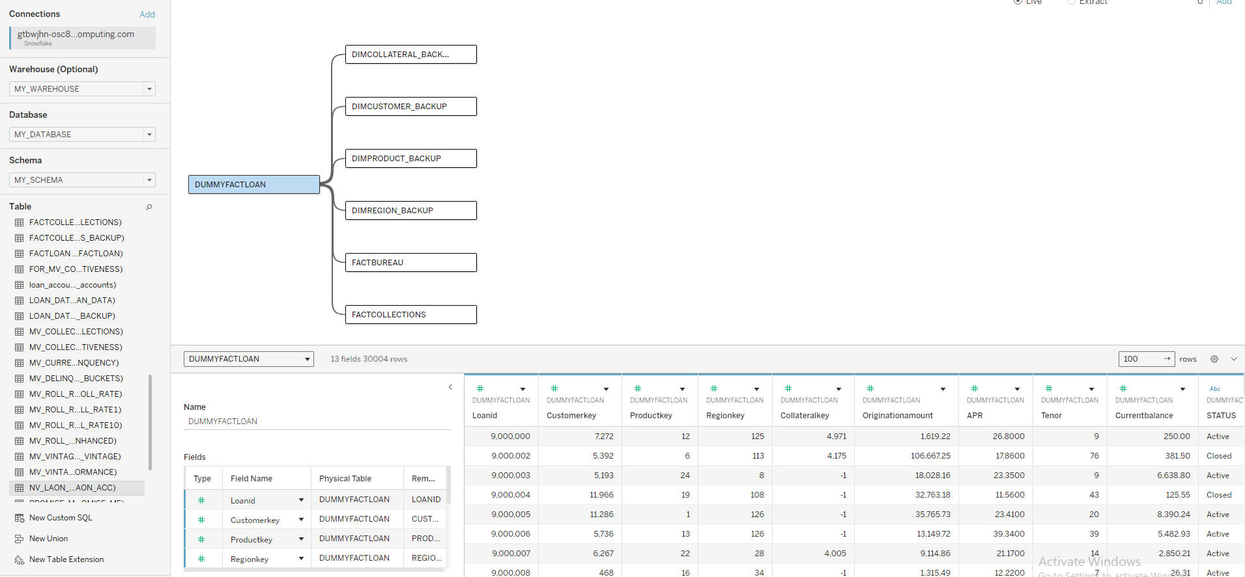
Tableau data source

Slide 26
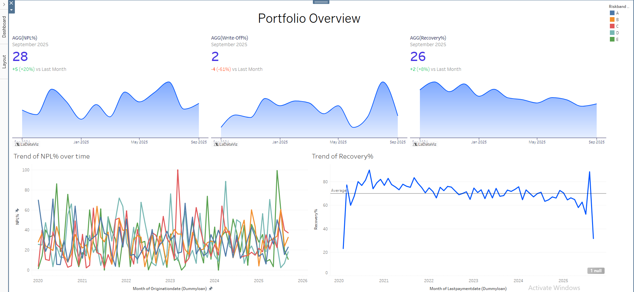
Dashboard 1:

Slide 27
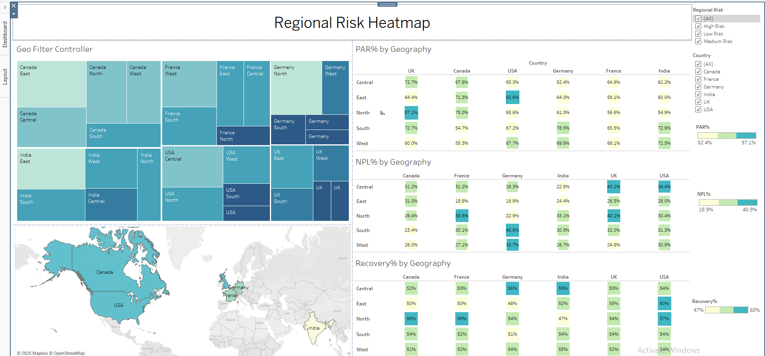
Dashboard 2:

Slide 28
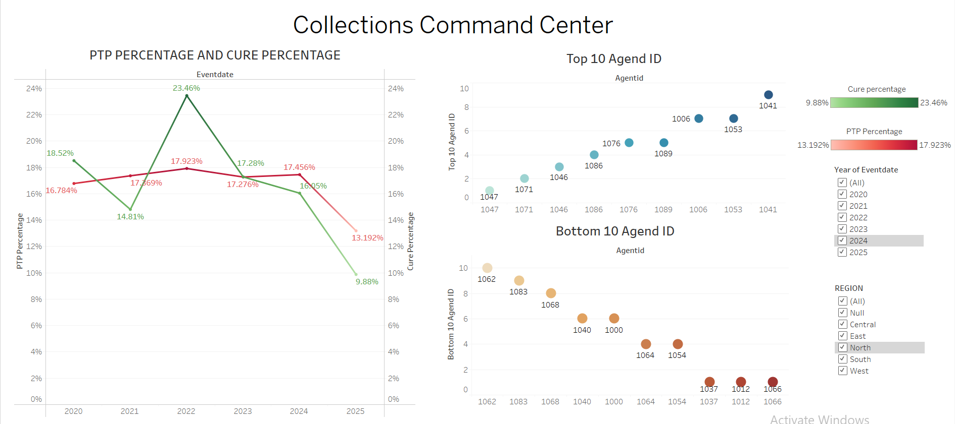
Dashboard 3:

Slide 29
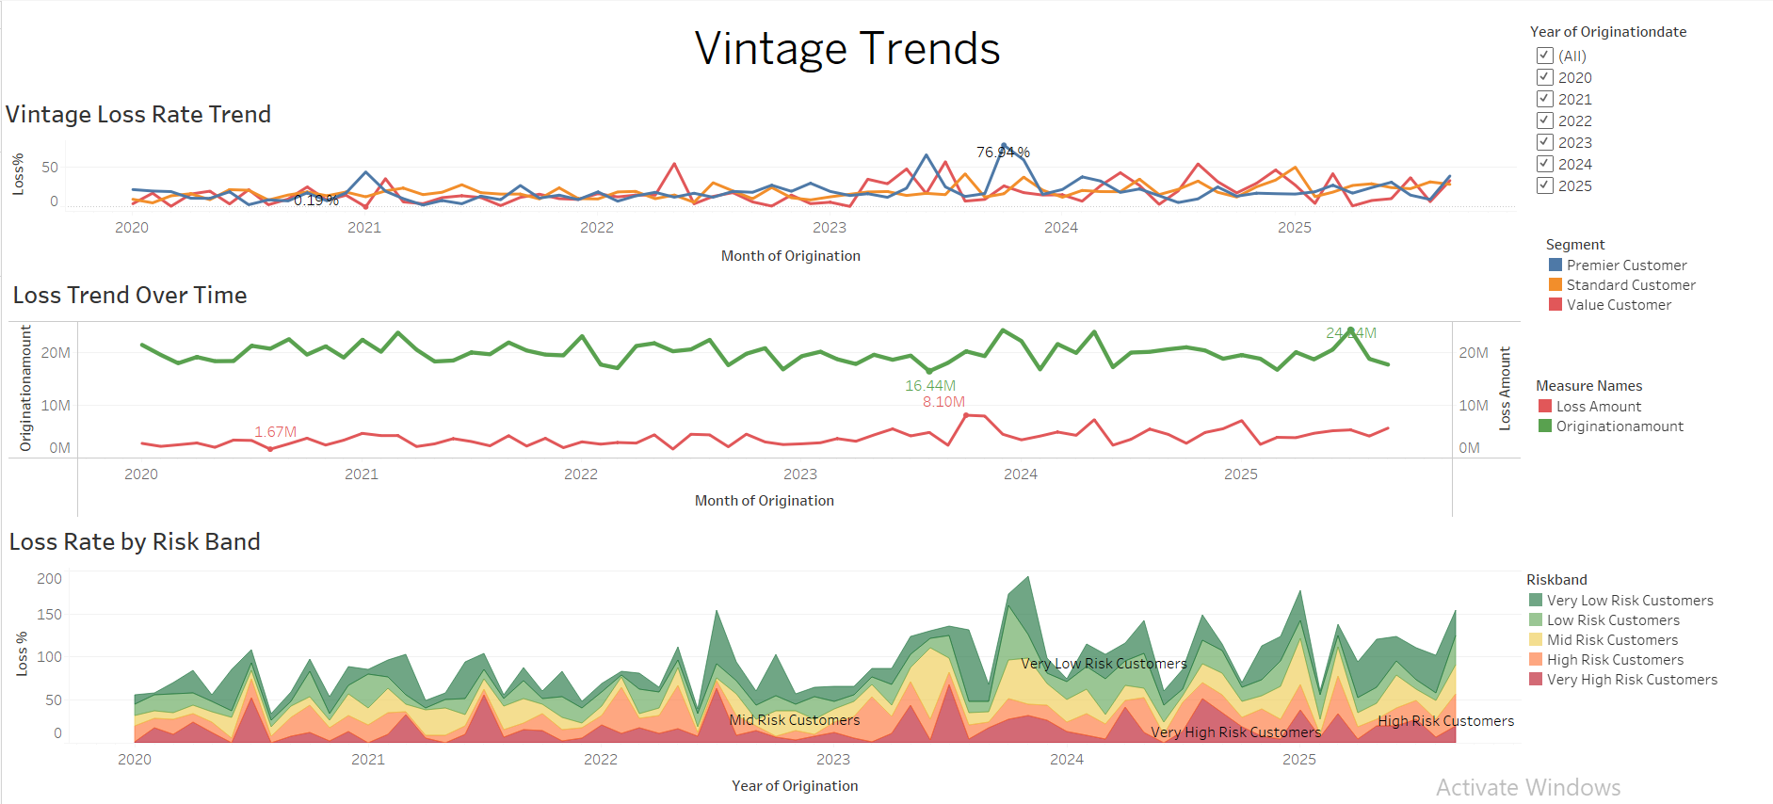
Dashboard 4:

Slide 30
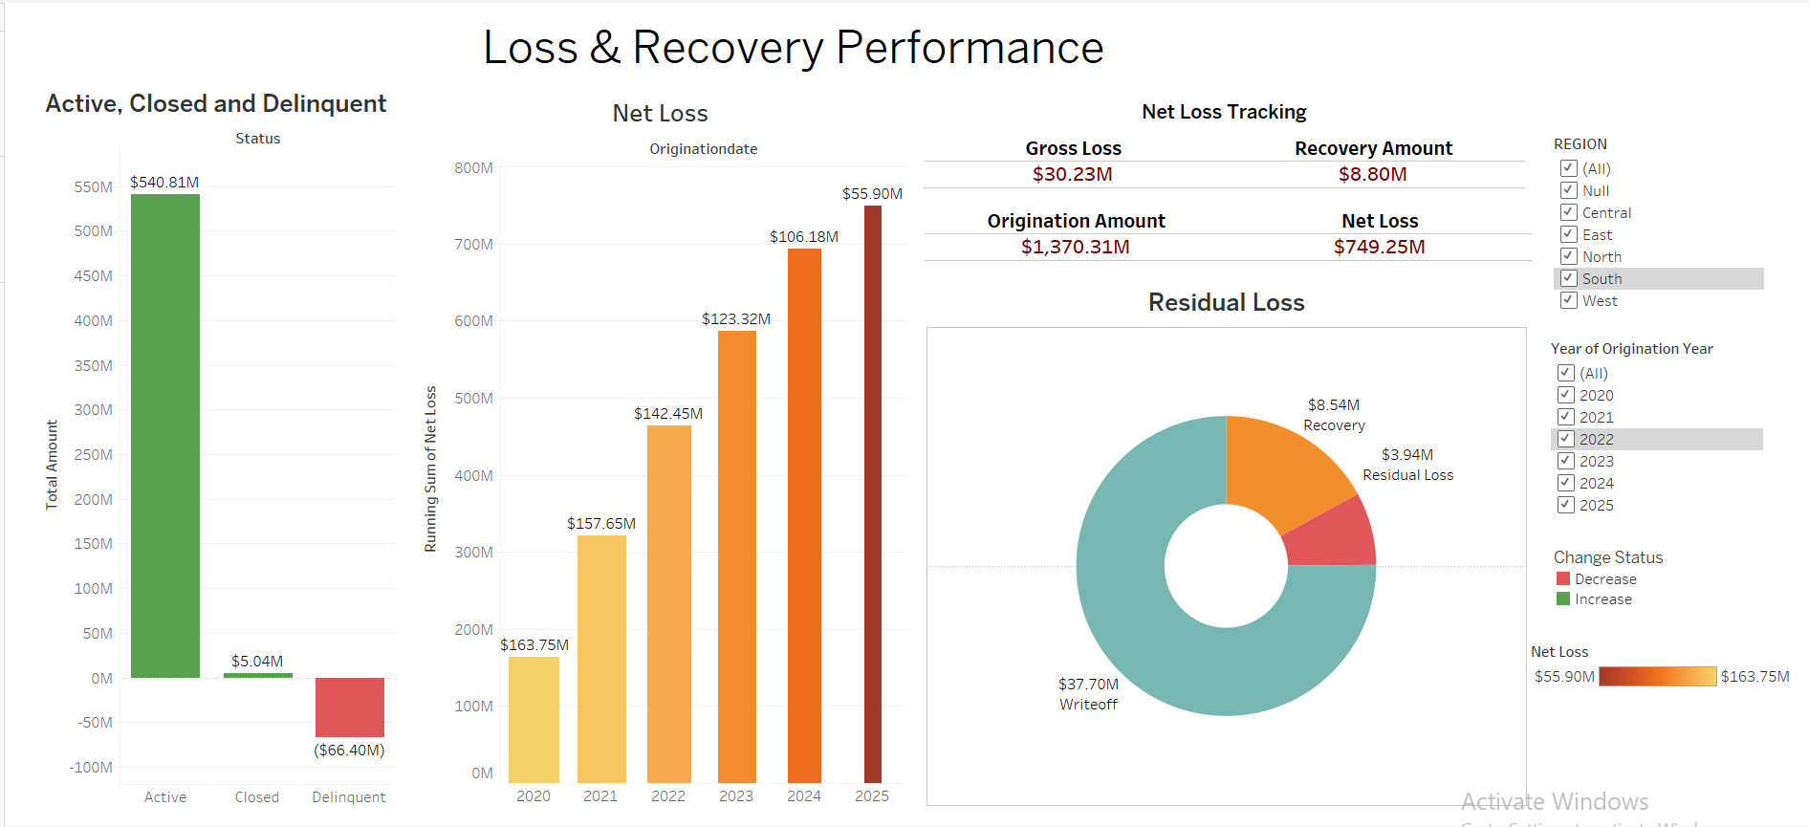
Dashboard 5:

Slide 31
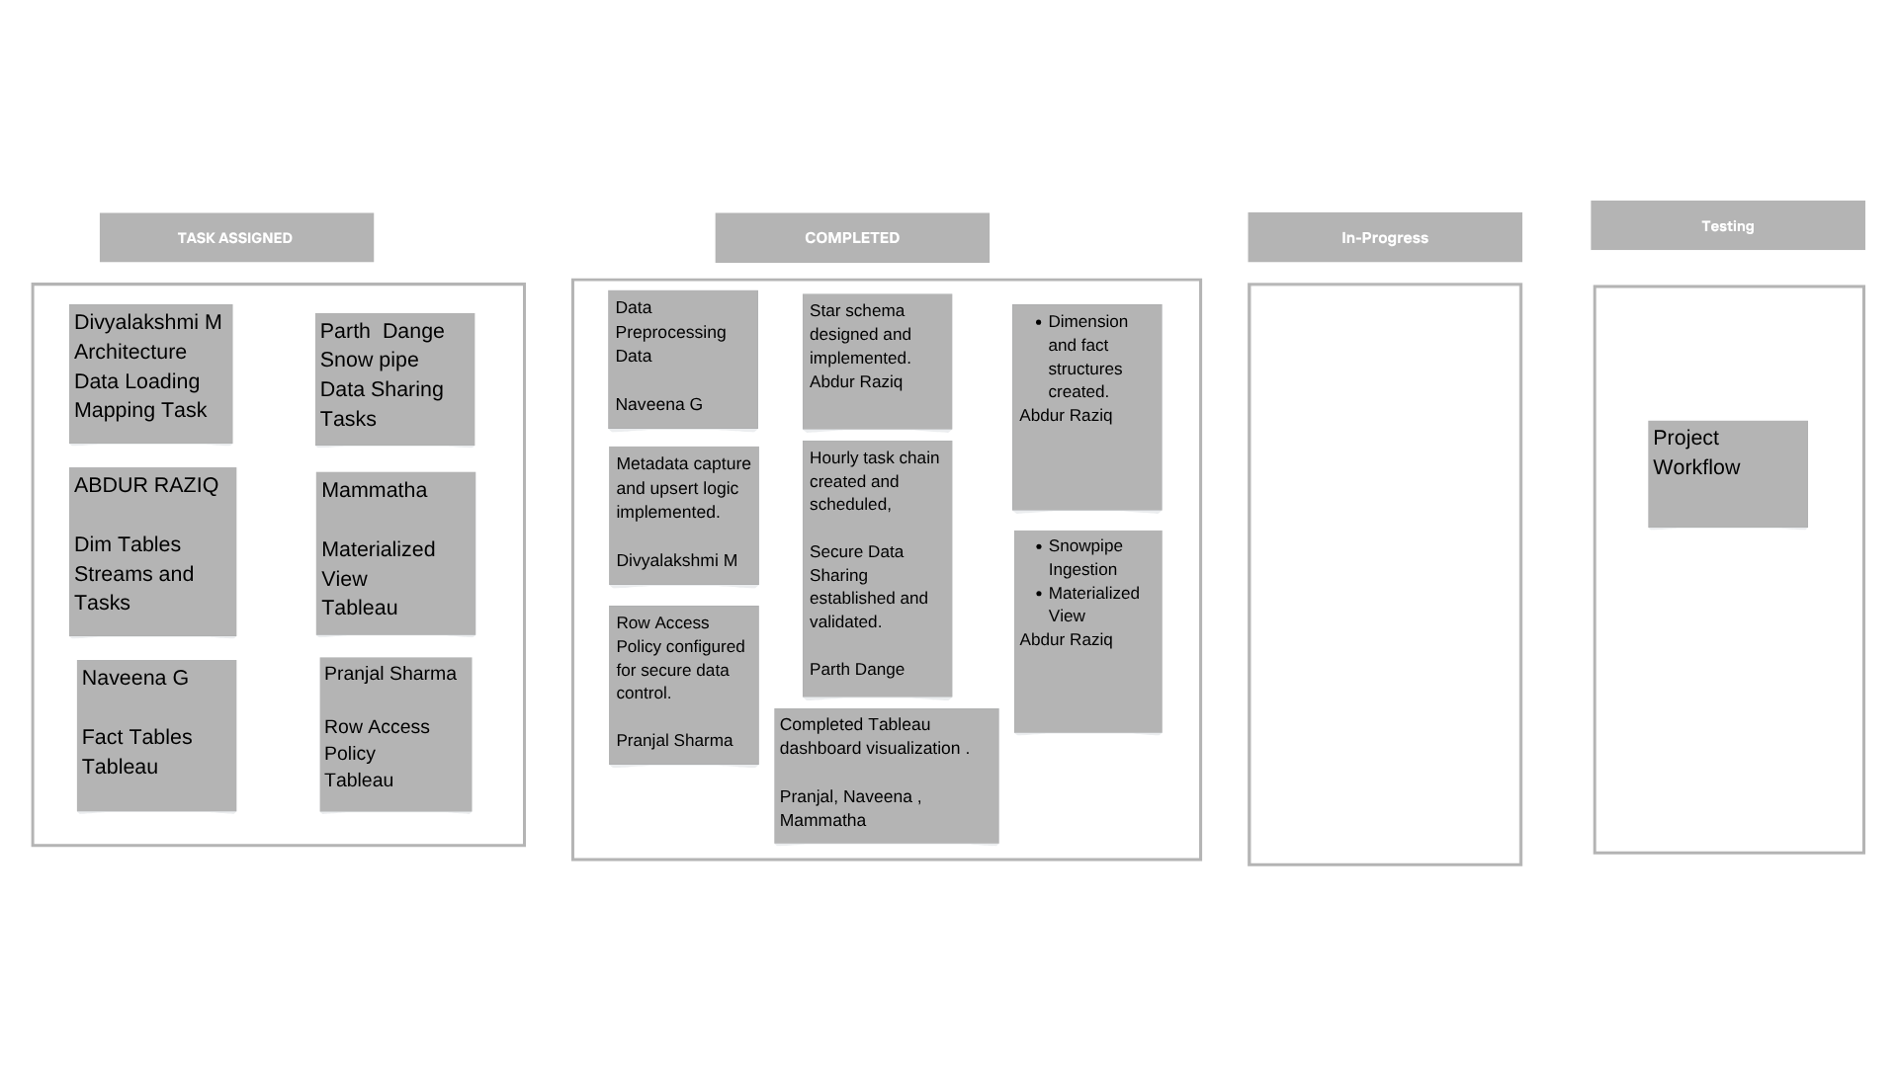
Kanban Chart

Slide 32
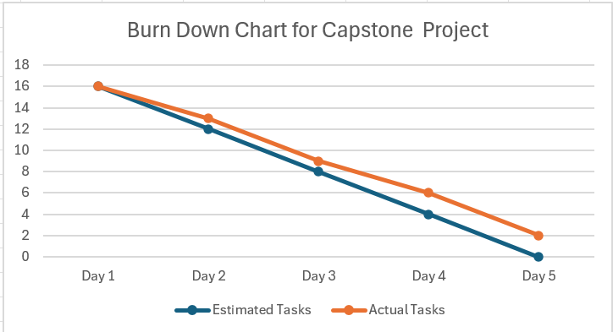
Burn Down Chart

Slide 33
Thank you

